Slide 4
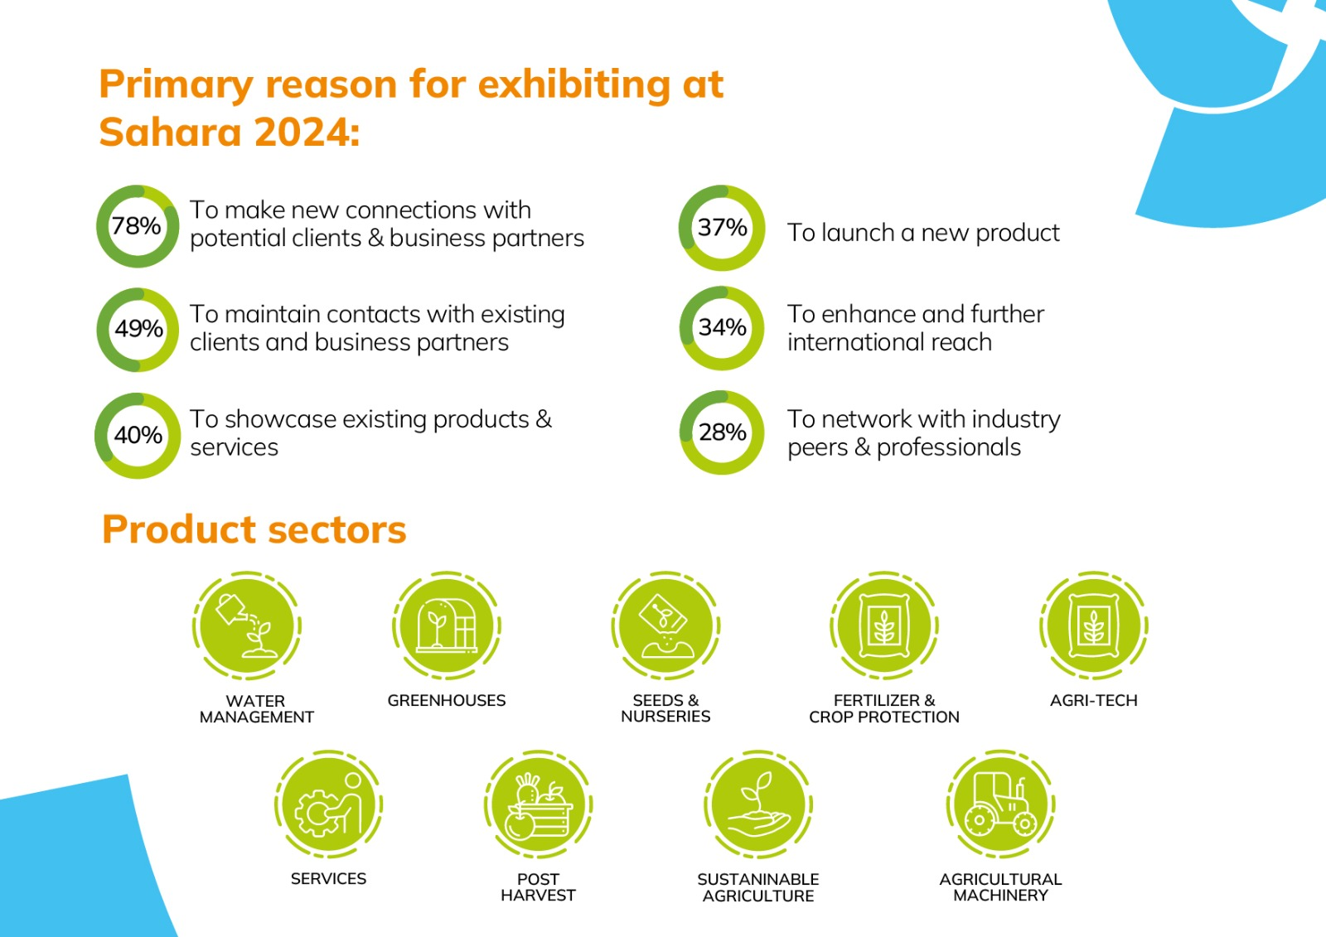

Slide 7
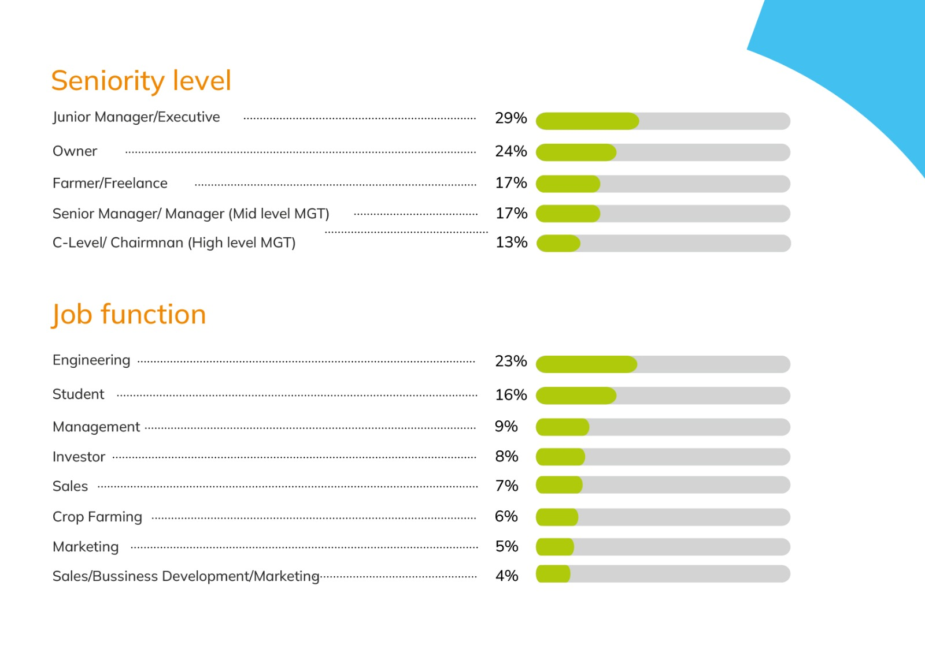
Value Proposition
Market Overview
SWOT Analysis
Sahara 2024 Achievement- Actual vs Target
2025 Objectives on Goals, Targets and Action Plan
Sectorial Analysis and Breakdown to Sector Investment
Revenue Increase
Competitive Advantages 3
Informa Market 2024© saharaexpo.com

Slide 9
Content

Slide 10
4. Inform Future Improvements
Actionable Insights:
Use the insights gathered from the analysis to make data-driven decisions for future exhibitions.
Adjust marketing strategies, exhibitor packages, and educational content based on participant preferences and feedback.
Continuous Improvement:
Establish a continuous improvement cycle, ensuring lessons learned from each exhibition are incorporated into planning for future events.
Foster a culture of learning within the organizing team to keep refining the approach.
Informa Market 2024 saharaexpo.com

Slide 11
Thank You

